Slide 1

Community Law Project
We meet clients where they are

Slide 2
Our Mission and Impact on the Community
The California Western Community Law Project (CLP) provides legal advice to low-income and indigent members of the local San Diego community through our student run legal clinics
To date, CLP has served over 6,000 clients in a wide variety of legal specialty areas.
We have provided over 400 law students with the opportunity to work in a community based legal clinic.
The lasting experiences gained through CLP create an awareness of the hardships faced by the poor and inspire participants to use their legal training to make a difference in the community.

Slide 3
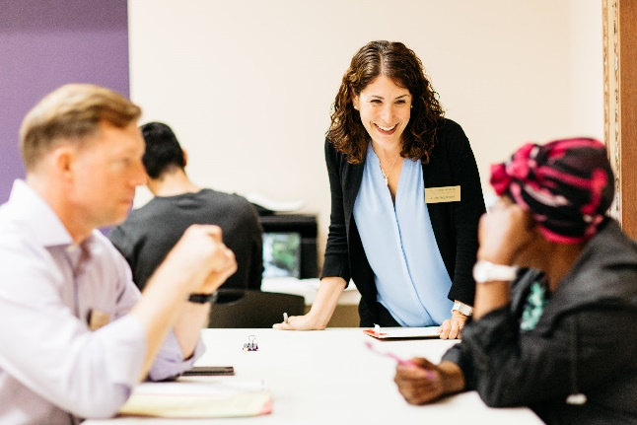
What is CLP?
CLP provides pro bono legal services, including legal advice, consultations, and referral services, to low-income people in the greater San Diego community.
Founded in 2005, CLP is a program of California Western School of Law. At many of its legal clinic sites, CLP collaborates with other organizations to provide clients access to needed social and medical services.

Slide 4
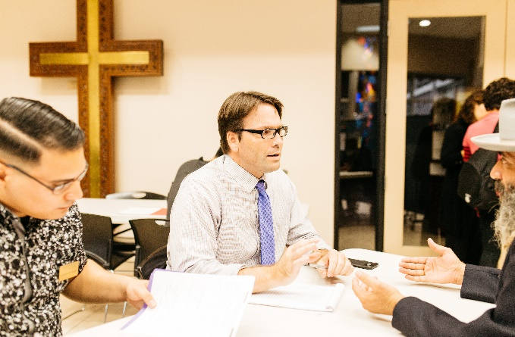
What does CLP do?
Legal advice, assistance, consultations with specialty attorneys, referrals
Services are free of charge
Community members seeking services must be San Diego County residents.
We primarily assist low income resident, and during periods of high call volume, may need to institute a MAXIMUM income threshold requirement
Clients must call intake line: 619-780-7498 or send an email to CLP@cwsl.edu to be screened before being scheduled for a virtual clinic.
Our virtual clinics are open to anyone that meets our eligibility criteria and is able to receive a private call.
Law students perform intakes via phone and are supervised by a licensed attorney on video.
3 clinics a week
Spanish interpretation available

Slide 5
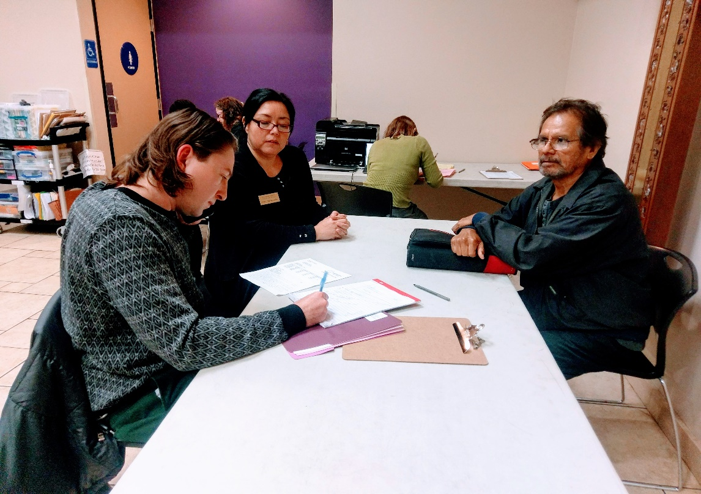
Who can CLP help?
CLP services are available to anyone seeking legal assistance, including: homeless, disabled, immigrants, or individuals otherwise without access to legal services.

Slide 6
Where is CLP located and what are the hours?
CLP is conducting all of its clinics virtually. For up-to date information on clinic schedules, please refer to our website https://cwclp.org/contact/ or call 619-780-7496.
Please note that the above number is a google number. Please ask clients to leave a message and a best time to call. Phone calls are typically returned within 2 business days

Slide 7
How to Sign up for Our Virtual Legal Clinics
1. Call our intake line at 619-780-7498 and leave the following information
  Name
  Phone number
  Legal area you need assistance with
  Best time to call
2. A member of our team will return your call in approximately two business days to assess eligibility and give you information about our services
  During periods of high call volume, clients must meet residency and income requirements

Slide 8
How to Sign up for Our Virtual Legal Clinics Continued
3. Potential Clients are informed about the services we provide: brief legal advice, appointments with specialty attorneys and referrals
4. Limitations: We do not provide representation services
5. Clients are placed on a call list for an upcoming legal clinic that week or the following week
6. Clients must be available for a call during the entire window of the clinic time. We are not able to give an exact appointment time for an intake. Clients also must be able to receive a call from a private number.

Slide 9
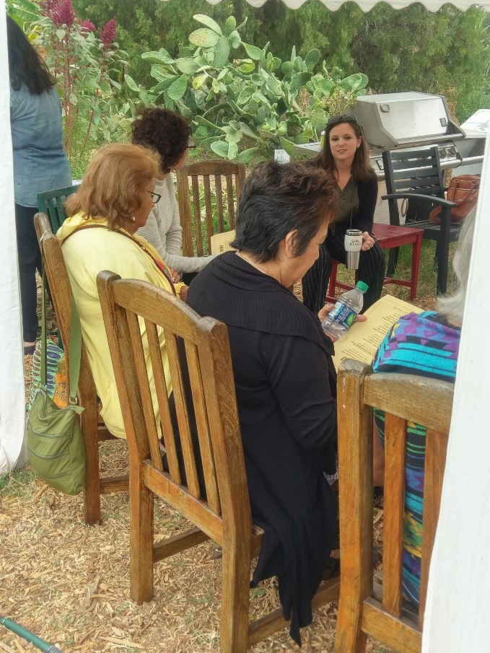
We may be able to help clients with these and other legal issues:
What do I do if I was kicked out of low income housing?
How do I get child support?
How do I deal with overdue bills and debt?
How do I file for divorce?
How do I get a criminal conviction off my record?
Do I have any immigration options to allow me to stay legally in the United States?
How do I get money from someone who hurt me or my property?
What should I do if I received an eviction notice from my landlord?
What should I do if I owe back taxes?
How do I create a will?
What do I do if my employer is not paying me overtime wages?

Slide 10
Common Issues we Frequently Assist with:
Divorce: talking to people about the process and what to expect
Housing: helping people understand what their rights and obligations are as a tenant
Personal Injury: information on how to sue someone for an injury or money they are owed
Estate: help in drafting a will or what to do if a loved one passed way without a will
Immigration: Find out if one is eligible for citizenship or DACA
We have strong relationships with other legal organizations across the county so when we cannot help someone, we try to connect them with a place that can help.

Slide 11
Clinic Days and Times
Monday Evenings
  5:30 p.m. to 8:00 p.m.
Tuesday Afternoons
  11:45 a.m. to 2:15 p.m.
Friday Mornings
  8:45a.m. to 11:15 p.m.
Notes:
A client can only get services during one of these times IF they are placed on our list after calling the intake line.

Slide 12
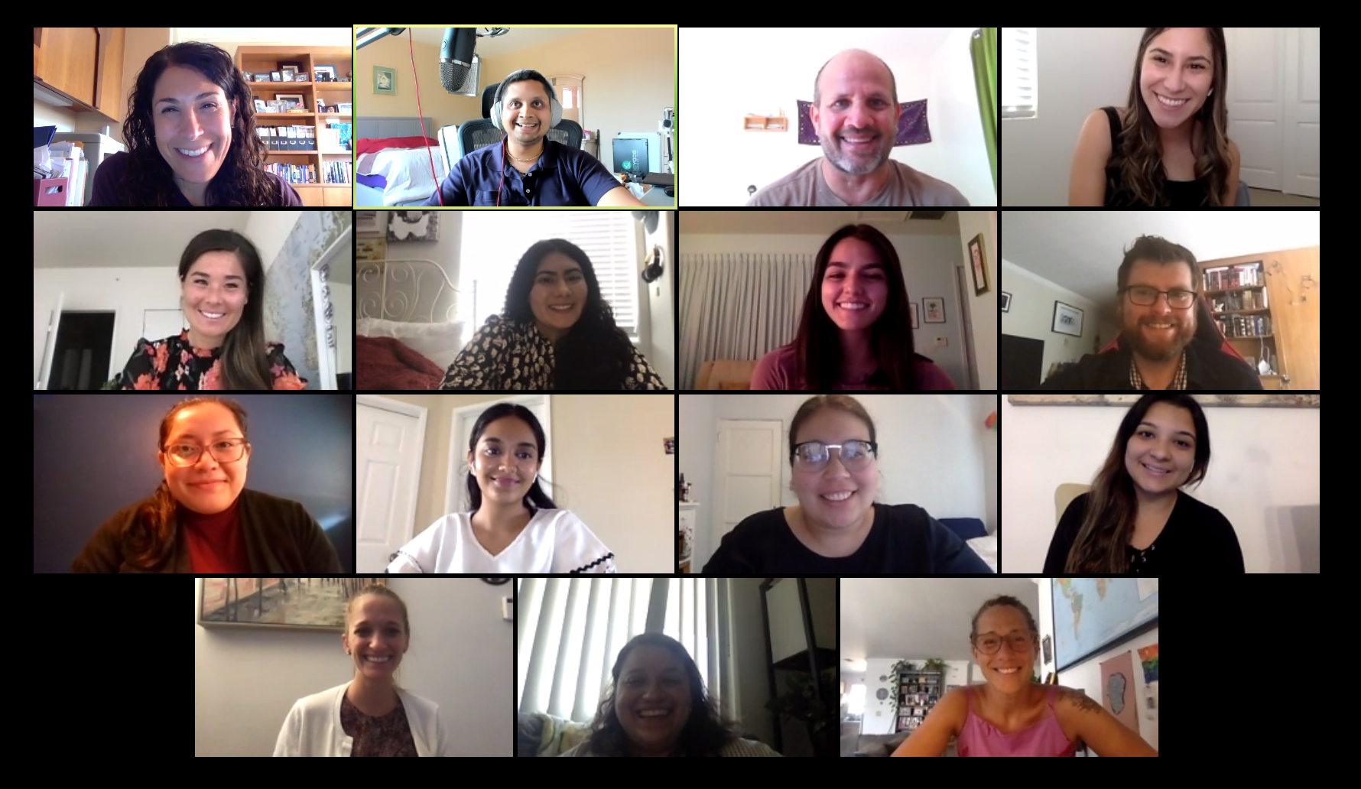
Questions?

